Slide 1
Knockout
Quick Intro

Slide 2
Two-way data binding with Observables
Create:
var observable = ko.observable(optionalValue);
Get value:
var value = observable(); // call without arg
Set value:
observable(newValue); // call with arg

Slide 3
Three fundamental types
Single value: ko.observable()
var max = {
firstName: ko.observable(“Max”),
lastName: ko.observable(“Pecu”)
}
Collections: ko.observableArray()
max.likes = ko.observableArray([“Music”, “Hiking”, “Swimming”]);
Virtual values: ko.computed()
max.fullName = ko.computed(function() {
return max.firstName() + “ ” + max.lastName();
}); // re-evaluating when any referenced observable changes

Slide 4
Binding to the DOM
HTML:
<div id=“root”>
<input type=“text” data-bind=“value: firstName” />
<input type=“text” data-bind=“value: lastName” />
<ul data-bind=“foreach: likes”>
<li data-bind=“text: $data” />
</ul>
<p>Welcome, <span data-bind=“text: fullName” />!</p>
</div>
JavaScript:
var rootElement = document.querySelector(“#root”);
ko.applyBindings(rootElement, viewModel);

Slide 5
Declarative Binding
data-bind=“text: fullName”
binding handler (name)
binding expression (value)
Multiple bindings on one HTML element:
<div data-bind=“text: name, visible: hasName”></div>

Slide 6
Binding handlers
Many built-in binding handlers:
text, html, css, foreach, if, click, enable, visible, value, hasFocus, checked, template, …
Adding custom binding handlers …
ko.bindingHandlers.jumpUpAndDown = {
init: function(element, valueAccessor, …) {
// Do one-time work…
},
update: function(element, valueAccessor, …) {
// Do things on every value change…
}
};
… then using it like any other binding handler:
<div data-bind=“jumpUpAndDown: isJumpy”></div>

Slide 7
Binding expressions and context
Normally a property of the current data context:
<div data-bind=“text: fullName”></div>
<!-- is equivalent to: -->
<div data-bind=“text: $data.fullName”></div>
Navigation within the context hierarchy:
<div data-bind=“text: $parent.description”></div>
Almost every valid JavaScript expression:
<div data-bind=“
text: fullName().length !== 0 ? fullName() : ‘N/A’
”></div>

Slide 8
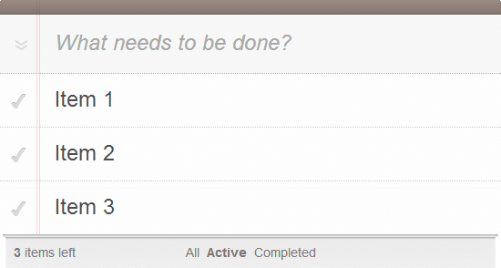
A view model for TodoMVC
var viewModel = {
current: ko.observable(),
todos = ko.observableArray(),
filteredTodos = ko.computed(…),
add: function() {},
remove: function() {},
removeCompleted: function() {},
remainingCount: ko.computed(…),
completedCount: ko.computed(…),
allCompleted: ko.computed(…),
editItem: function() {},
stopEdition: function() {},
showMode = ko.observable()
};
https://github.com/tastejs/todomvc/blob/gh-pages/architecture-examples/knockoutjs/js/app.js

